Slide 1
PCM Basics
Module-05

Slide 2
Contents
Internationalization
Catalogs
Media Management in hybris

Slide 3
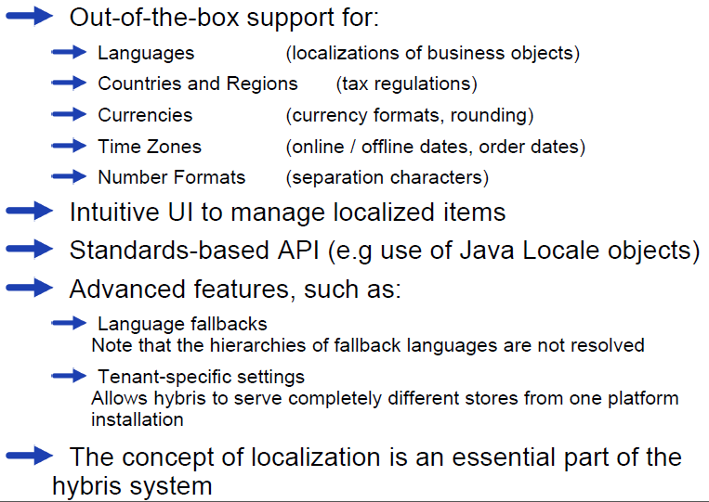
Core I18N Features

Slide 4
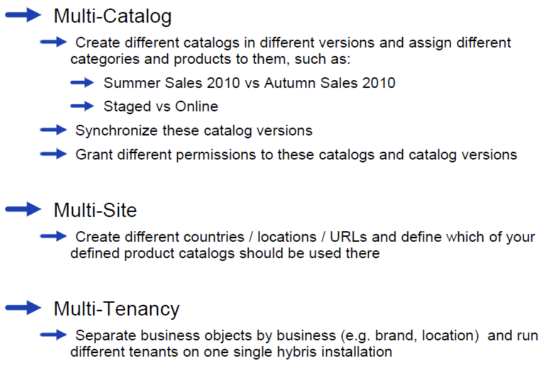
Other I18N-Relevant Areas Within hybris Systems

Slide 5
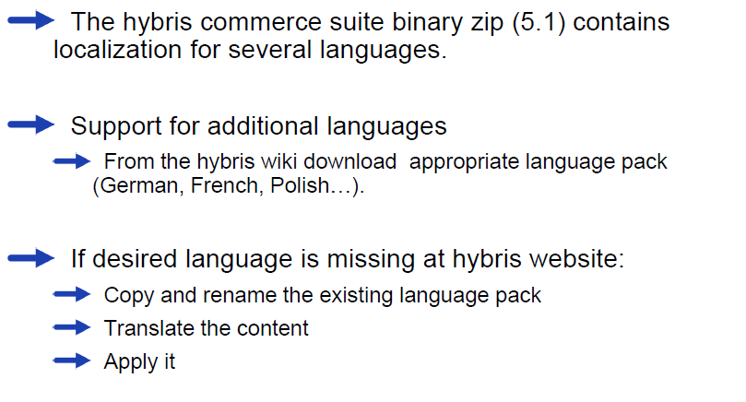
Language packs

Slide 6
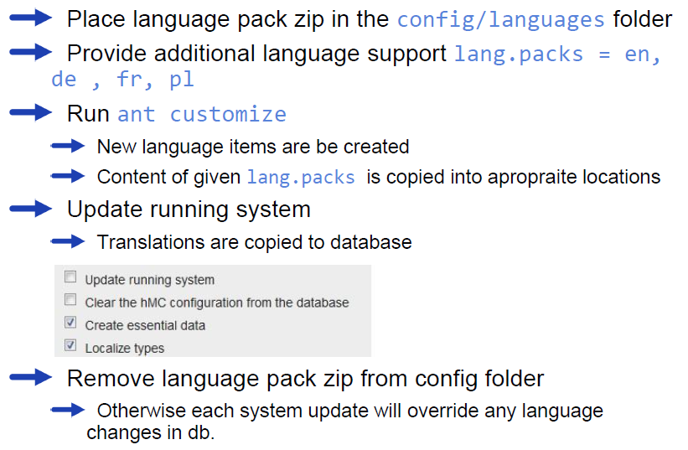
Language packs – how to apply them

Slide 7
Contents
Internationalization
Catalogs
Media Management in hybris

Slide 8
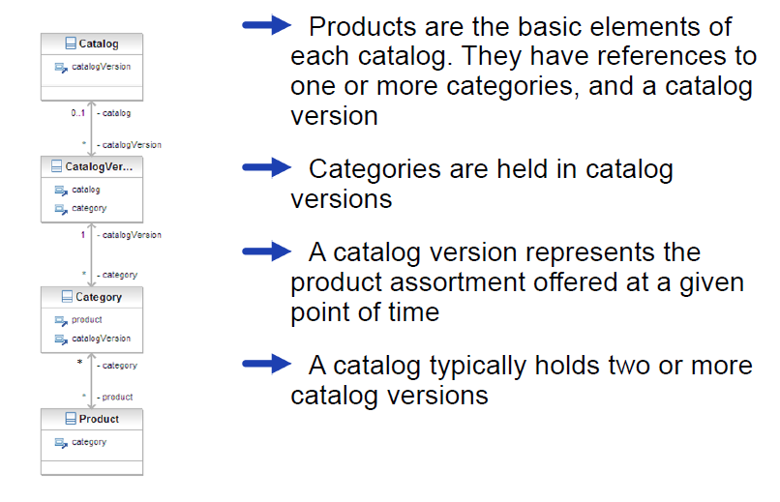
Catalog type structure

Slide 9
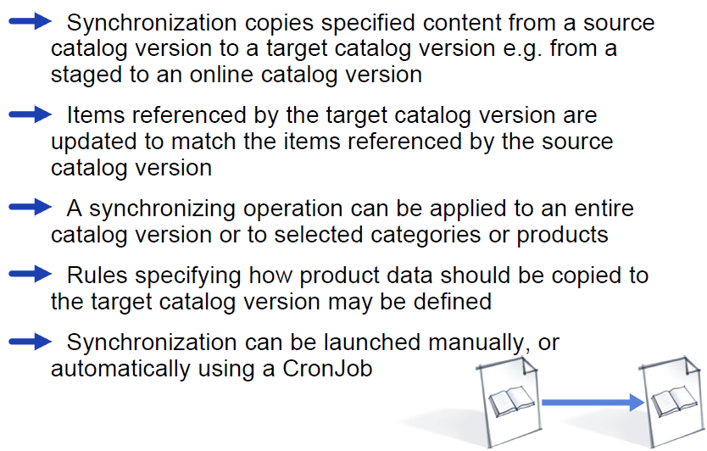
Catalog Versions - Synchronization

Slide 10
Contents
Internationalization
Catalogs
Media Management in hybris

Slide 11
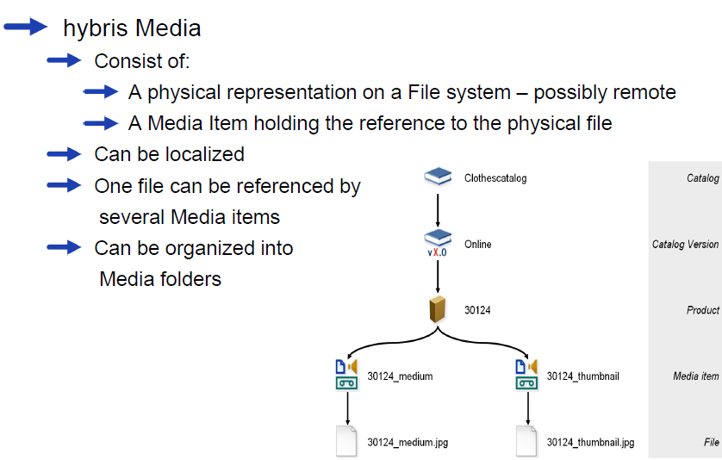
Media Management

Slide 12
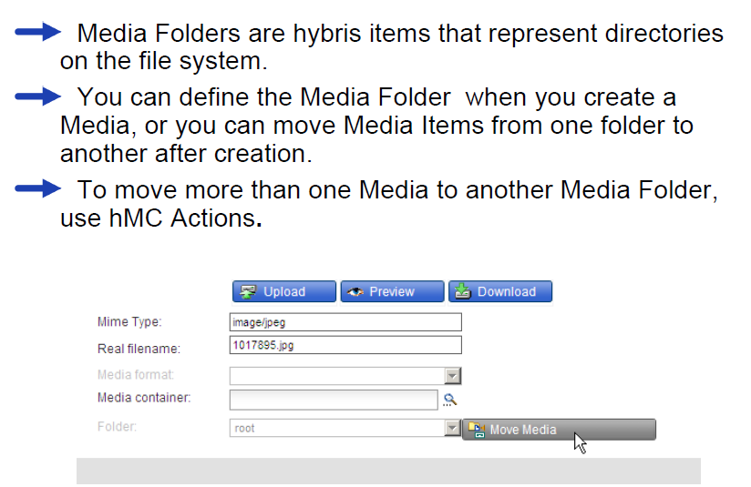
Media Folders

Slide 13
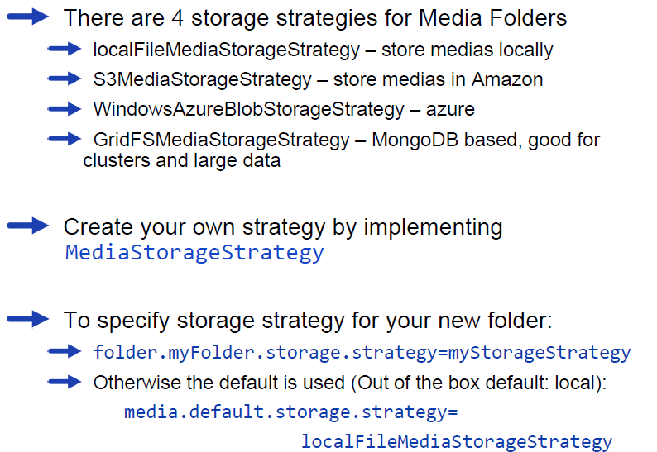
Media folder storage strategy

Slide 14
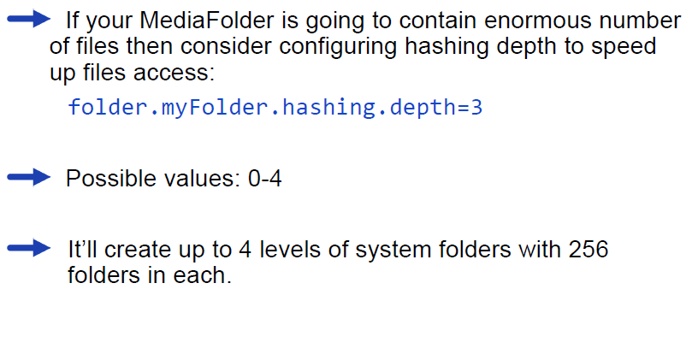
Media folder storage strategy

Slide 15
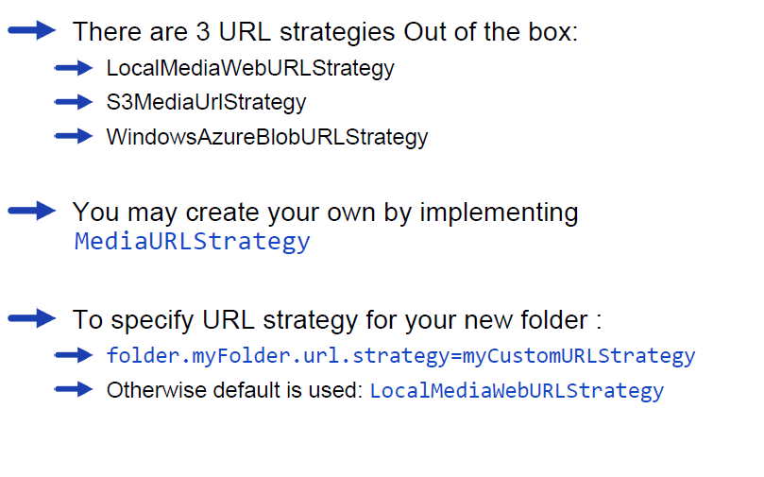
Media folder URL strategy

Slide 16
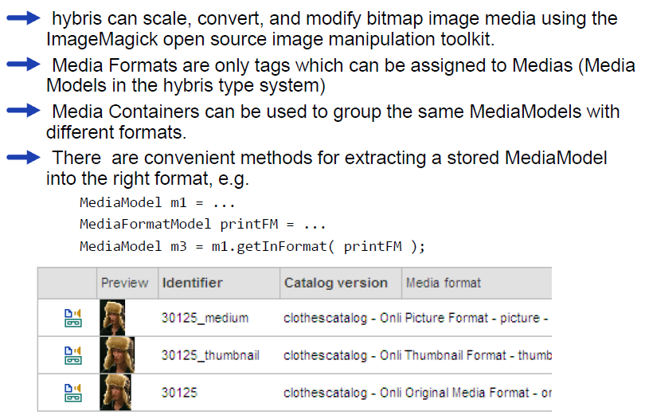
Media Formats and Containers

Slide 17
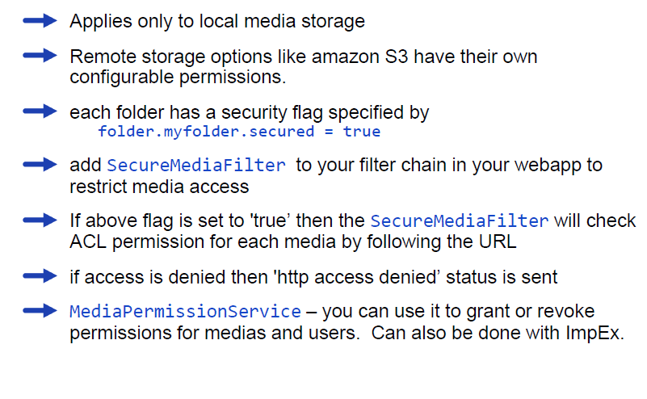
Secure medias

